Slide 1
Meeting 11/05/2020
Naudé Conradie
19673418

Slide 2
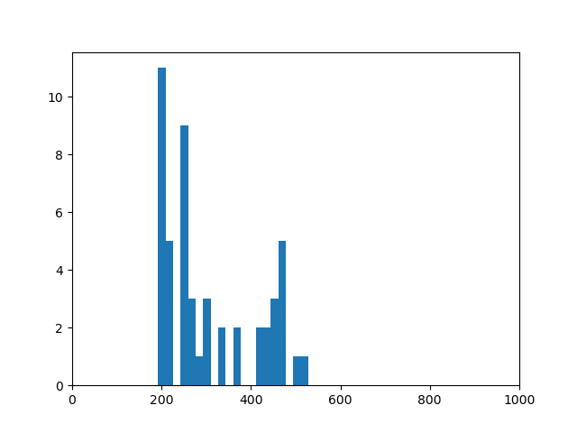
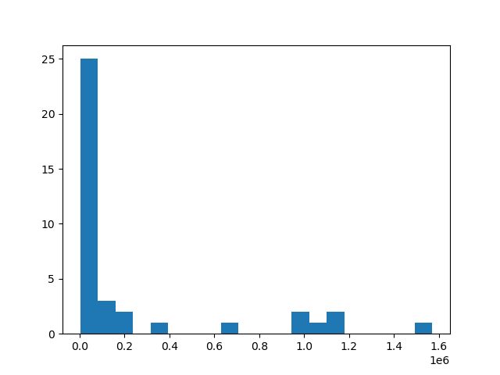
Monte Carlo Simulation
Run number of unit simulations
Check that same unit isn’t generated again
Plot histogram
Select models on lower end of histogram
Takes ±30s per simulation
<512 possible combinations for 5*5 grid
Specific books to look at?

Slide 3
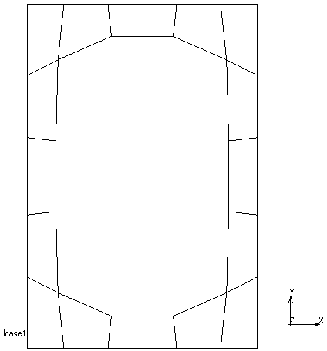
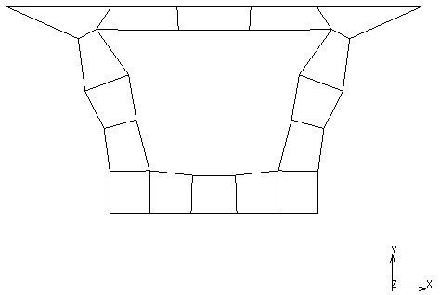
Templates

Slide 4
Code
Autodocumentation
pydoc
Generated html files
Feedback on code

Slide 5
Admin
SSD
Feedback on presentation

